Slide 1

GRUNDTVIG PARTNERSHIP PROJECT
The Results of
The Communication and Conflict Training Survey

Slide 2
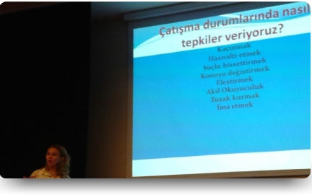
INFORMATION ABOUT THE SEMINAR
It was given by Ayşen Temen EĞİNLİ, the Assistant Professor at Ege University to 30 participants, on 10-11th June 2013

Slide 3
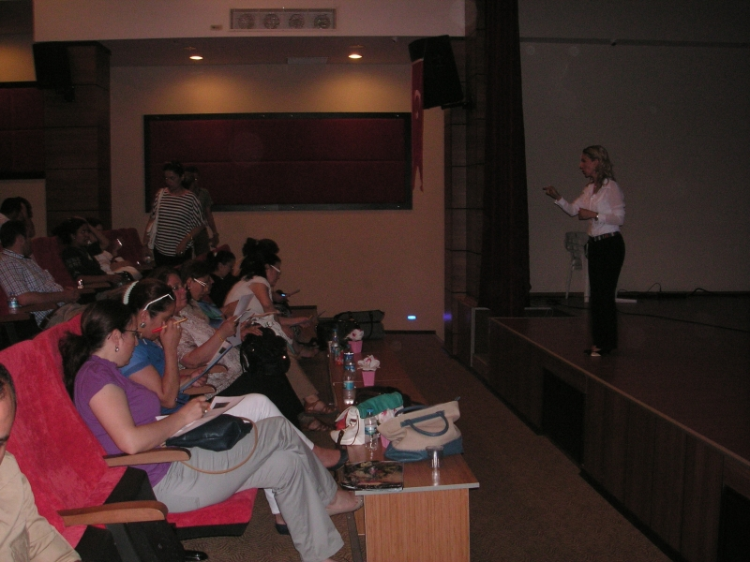
All participants are teachers in Turgutlu.
Almost all of them are above 30.

Slide 4
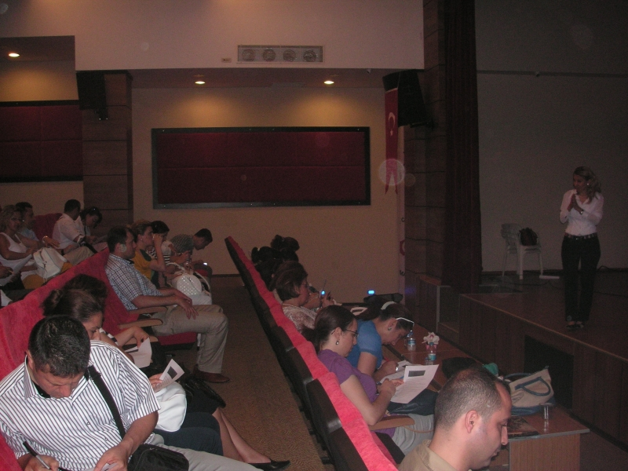

Slide 5
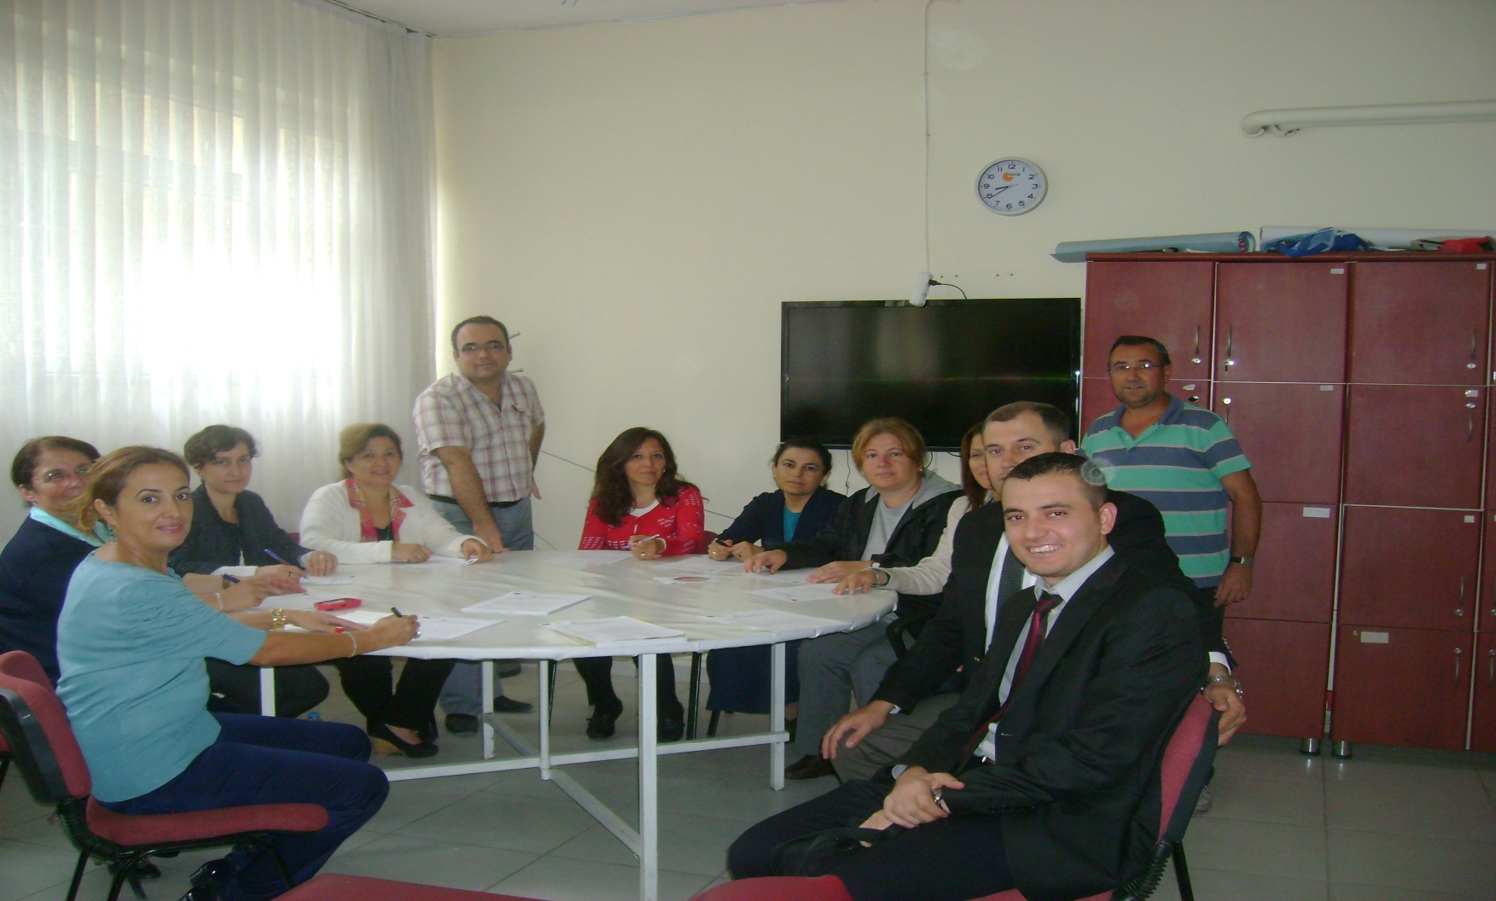
We prepared a survey to find out the impact of the seminar to the participants.

Slide 6
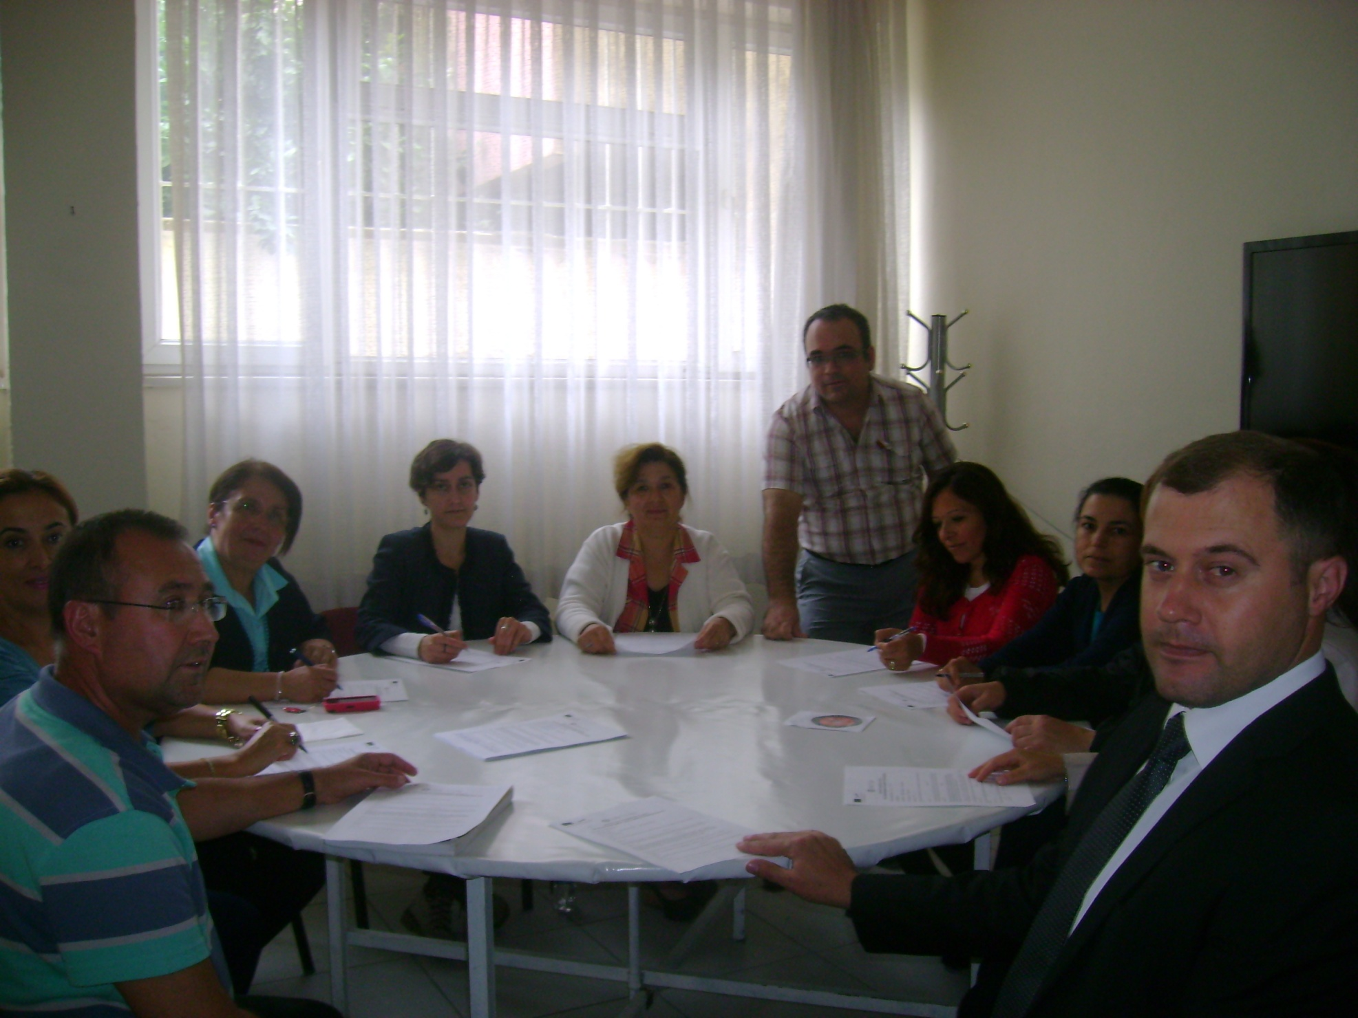

Slide 7
The Results
Almost all of them have had conflicts with learners or trainers.

Slide 8
The Results
Almost all of them have had conflicts with learners or trainers.
The conflict factors are: Age, personality, cultural level, Degree of motivation, Learning ability, Psychological state, Gender.

Slide 9
The Results
Almost all of them have had conflicts with learners or trainers.
The conflict factors are: Age, personality, cultural level, Degree of motivation, Learning ability, Psychological state, Gender.
They found the seminar useful.

Slide 10
The Results
Almost all of them have had conflicts with learners or trainers.
The conflict factors are: Age, personality, cultural level, Degree of motivation, Learning ability, Psychological state, Gender.
They found the seminar useful.
They are eager to attend similar seminars.

Slide 11
THANK YOU
Turgutlu İlçe Milli Eğitim Müdürlüğü
Aydin Maramuroglu
Levent Uslu

